Slide 1
Welcome
…..

Slide 2
3 Weeks of Training + demo
15 DAYS
48 HOURS
2,880 MINUTES
172,800 SECONDS
Limitless knowledge

Slide 3
Framework for 3 Weeks
First Week:
Understanding Use case and Implement basic UI using HTML5,CSS3 and Javascript
Second week:
Implementation of UI using React component , React Bootstrap.
Final Week:
Implementation of UI React Routing and Fetch data from JSON server using AXIOS.

Slide 4

Our Journey
Notes:
Time - 2 mins

Slide 5
Mindset
Process
Tools
4
Project presentation
Comprehend
3
Integrating with React component
2
Visual Studio Code
1
Understanding HTML/CSS/Java cript

Slide 6

Project Goals
Notes:
Time – 3 mins

Slide 7
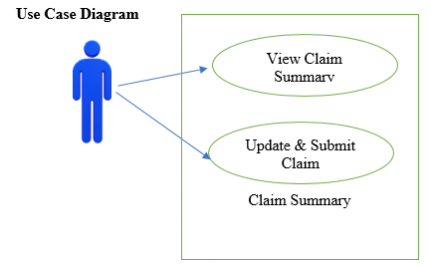
Scope of the System
The client would like to develop an independent application Update and Submit claim summary application in order to automate the process of managing the activities.

Slide 8
Our Vision
To develop an independent application Update and Submit claim summary application in order to automate the process of managing the activities.
The following section will focusing on the front-end features.
a).View Claim summary
b).Update & Submit Claim summary
Notes:
User satisfaction and brand value

Slide 9

Tools Used
Notes:
Time – 2 mins

Slide 10






Frontend
Data Base
Tool
Notes:
Time – 1 min

Slide 11

Development
Notes:
Time – 1 min

Slide 12
Sprint Planning
Deliver two milestones for Project
Spring Grooming
Requirement understanding
Sprint Implementation
Create React component
Delivery
To create react app
Fetch data and update data from JSON server
Notes:
Time – 1 min

Slide 13

Challenges & Learnings
Notes:
Time – 2 mins

Slide 14





Challenges & Learnings
1
2
3
4
5
Mindset
Estimation
Communication
Management
Leadership
Change from Coding Mindset to
Product Engineering Mindset
No idea about estimation to better estimation of tasks.
Silence in the room to daily individual & team discussions.
From spill overs to finishing the tasks on time and logging them.
From managing ourselves to managing the whole team.
Notes:
User satisfaction and brand value

Slide 15

Demo
Notes:
Time –
Architecture – 5 mins
NFR Dashboard – 3 mins
Demo – 10 mins
1. Show the Responsiveness and Wave tool first

Slide 16
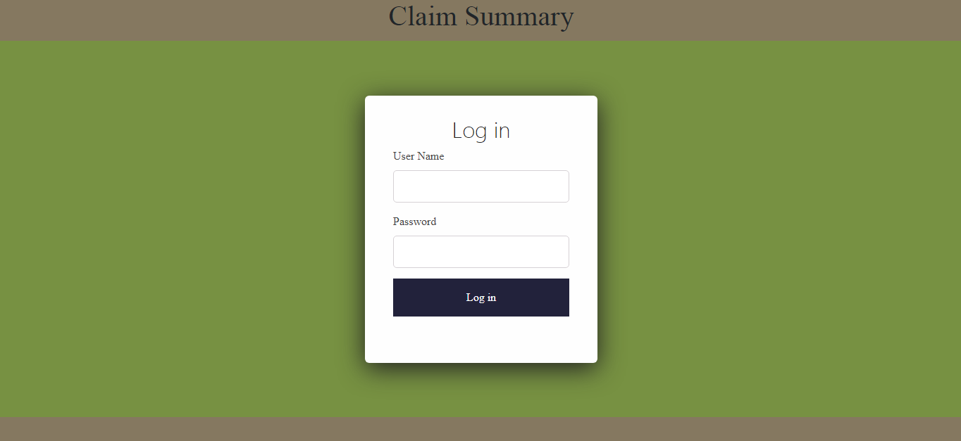
Login

Slide 17
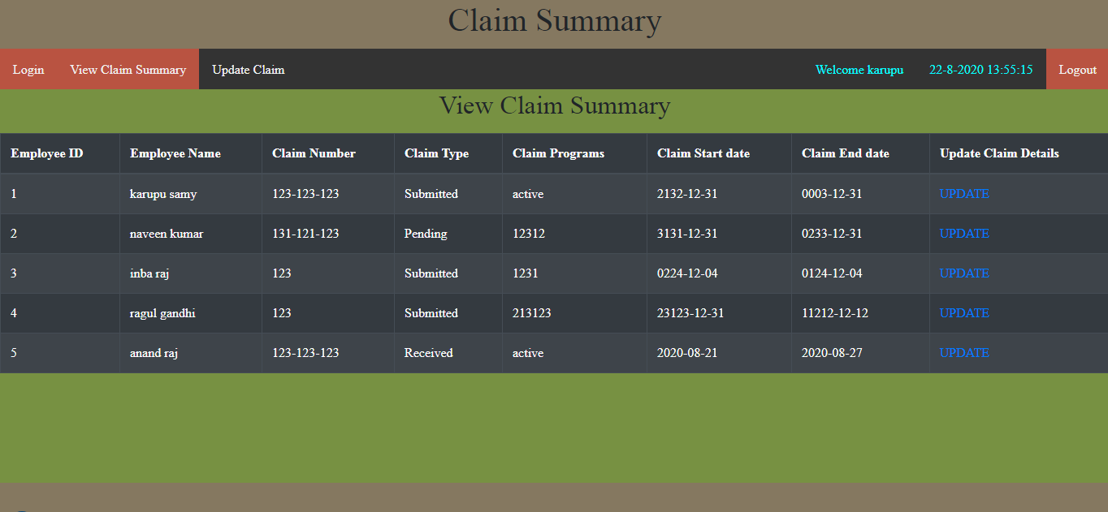
Claim List

Slide 18
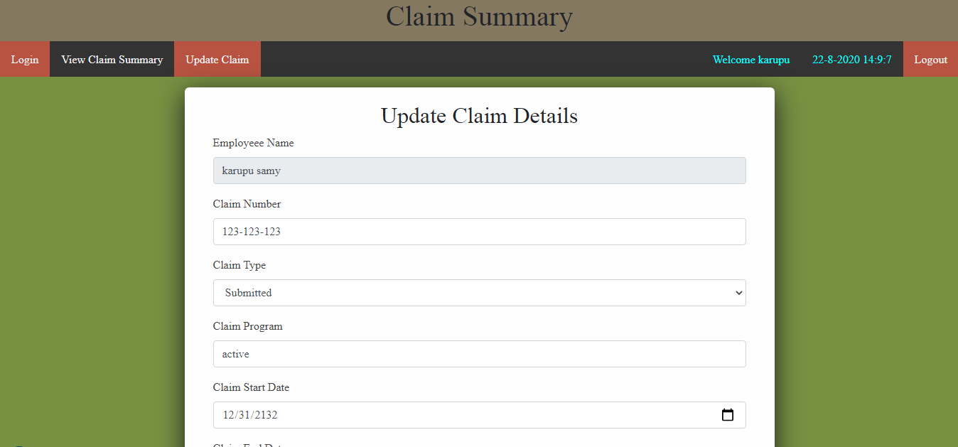
Update Claim

Slide 19
Thank you
Notes:
Time – After this show the testimonial video. 1 min

